Slide 1
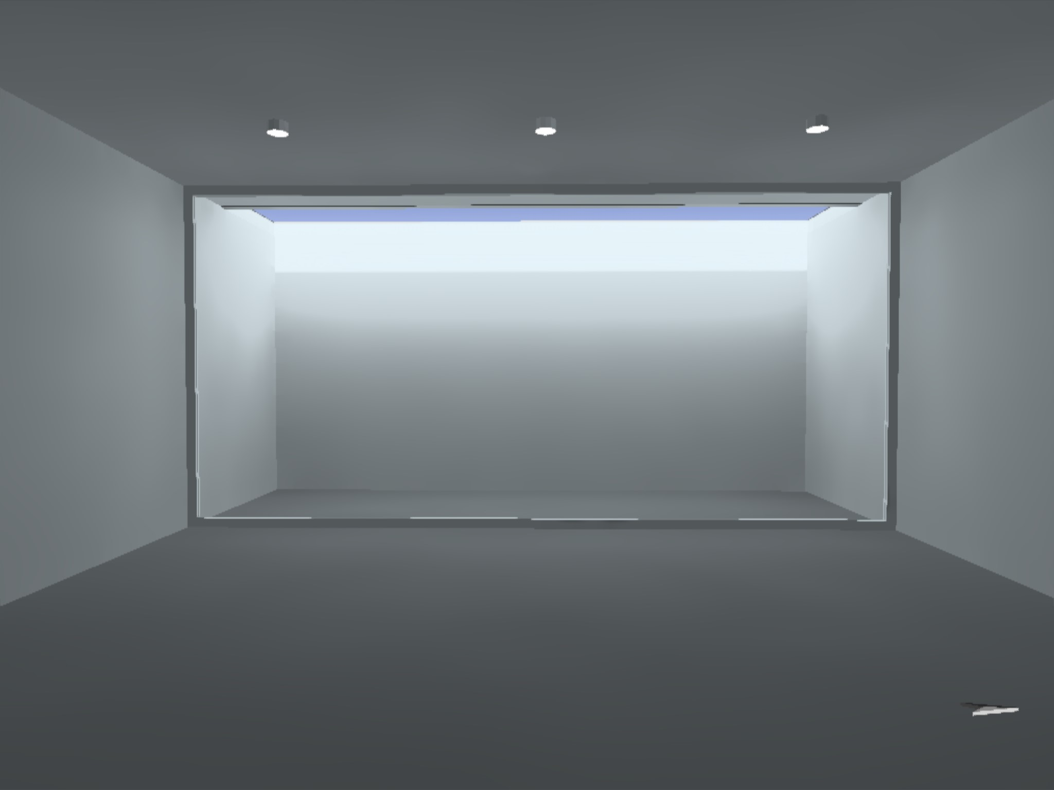
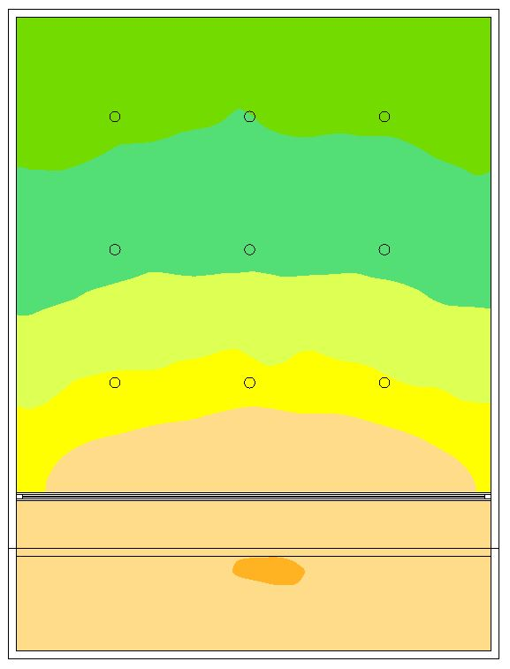
250-300 lx
300-500 lx
500-700 lx
700-1000 lx
1000-2000 lx
2000 lx
Daylight Analysis | DiaLux
Cut-out: 1.8m Wide
10AM, 21st June ‘19
GNLU, Gandhinagar

Slide 2
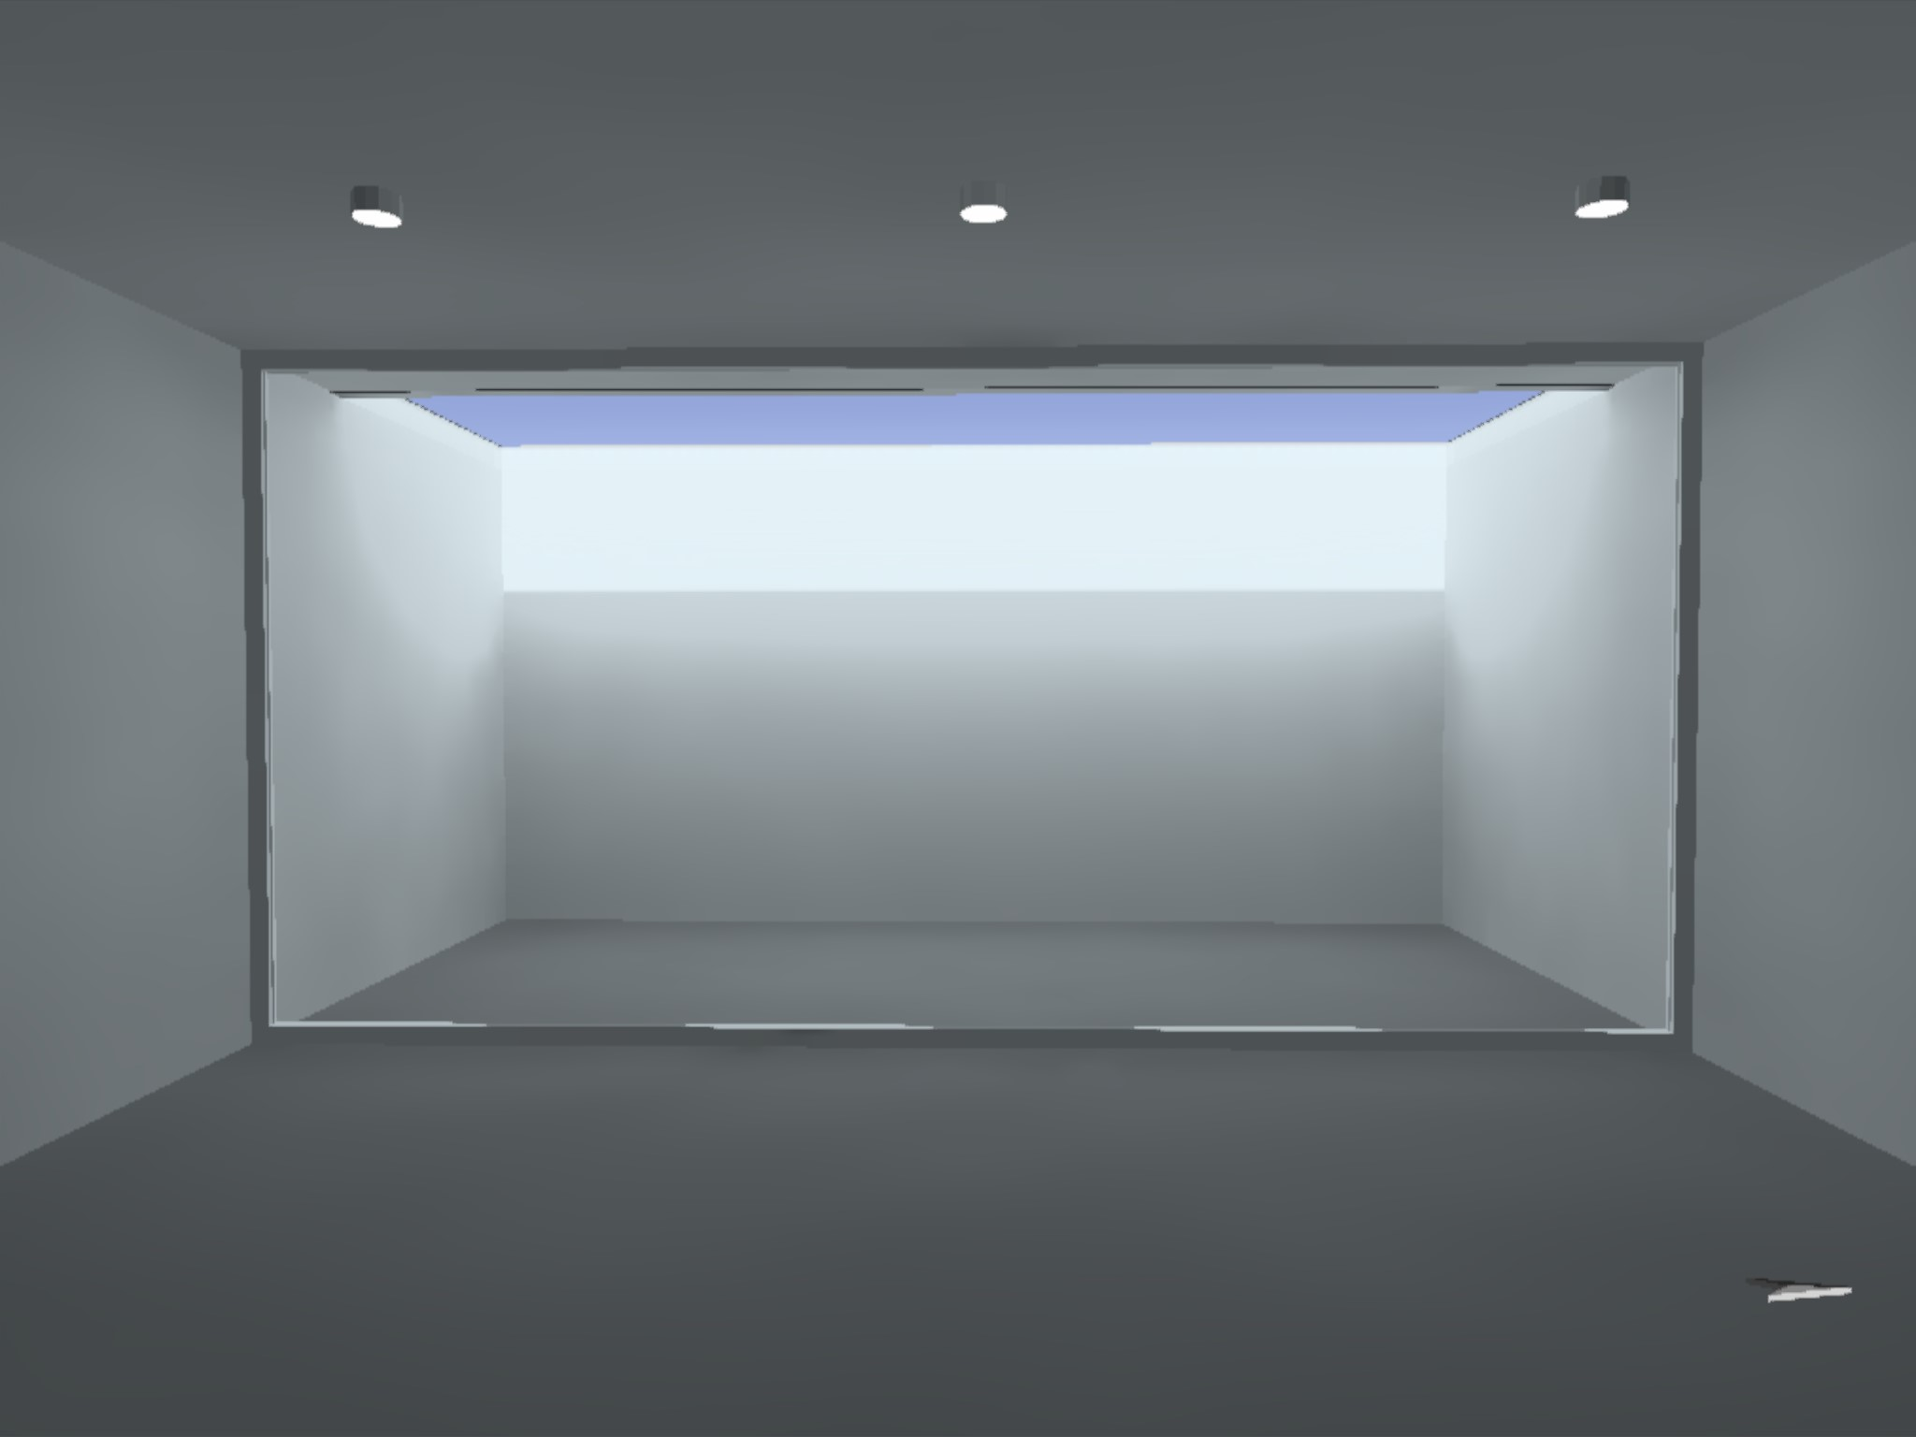
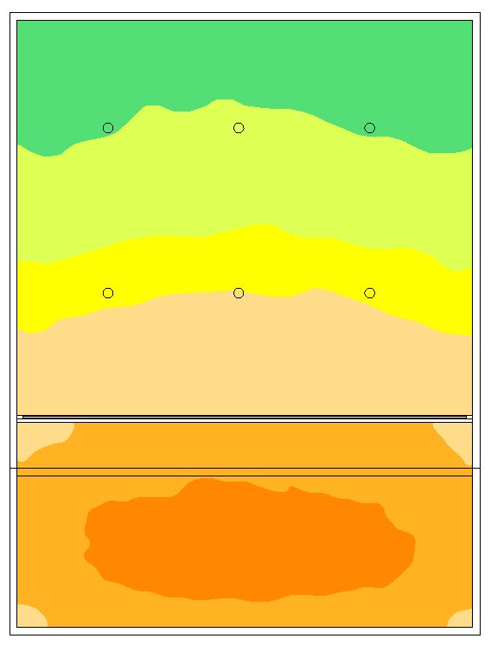
~500 lx
500-700 lx
700-1000 lx
1000-2000 lx
2000-3000 lx
3000-3500 lx
Daylight Analysis | DiaLux
Cut-out: 3.0m Wide
10AM, 21st June ‘19
GNLU, Gandhinagar

Slide 3
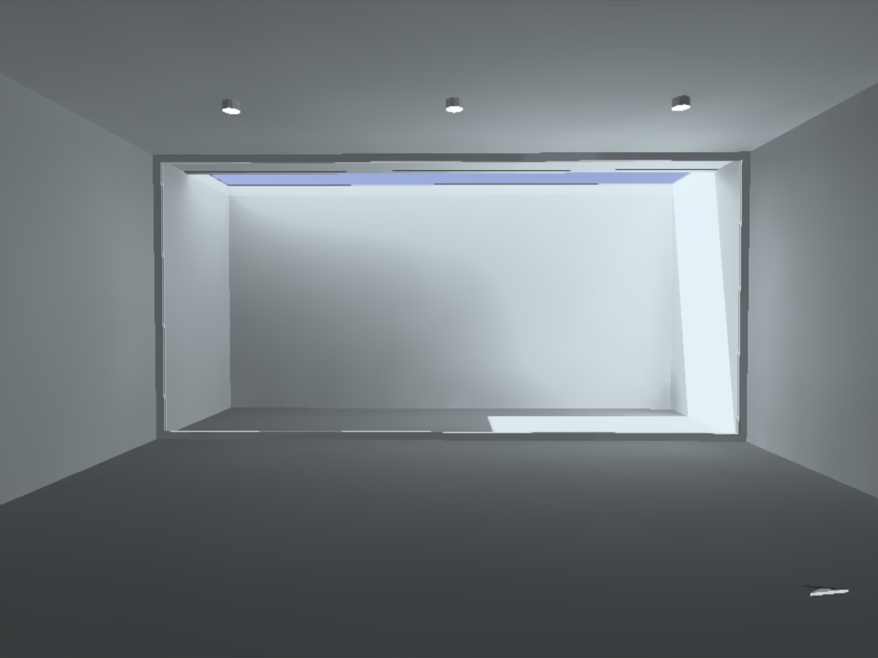
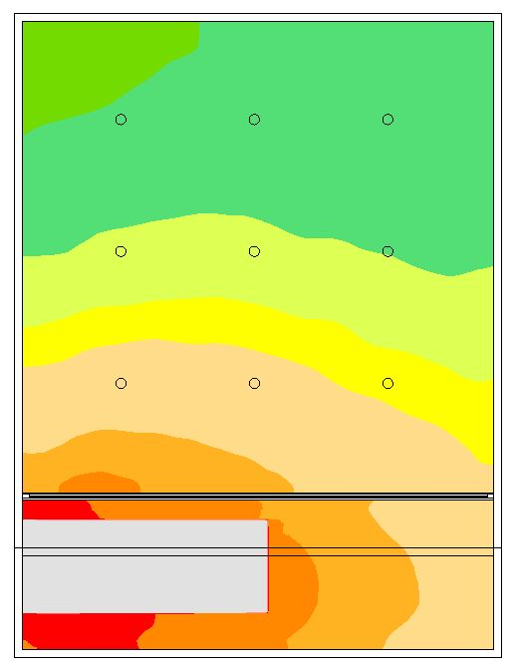
300-500 lx
500-700 lx
700-1000 lx
1000-2500 lx
2500-3000 lx
3000-4000 lx
Daylight Analysis | DiaLux
Cut-out: 1.8m Wide
04PM, 21st June ‘19
GNLU, Gandhinagar

Slide 4
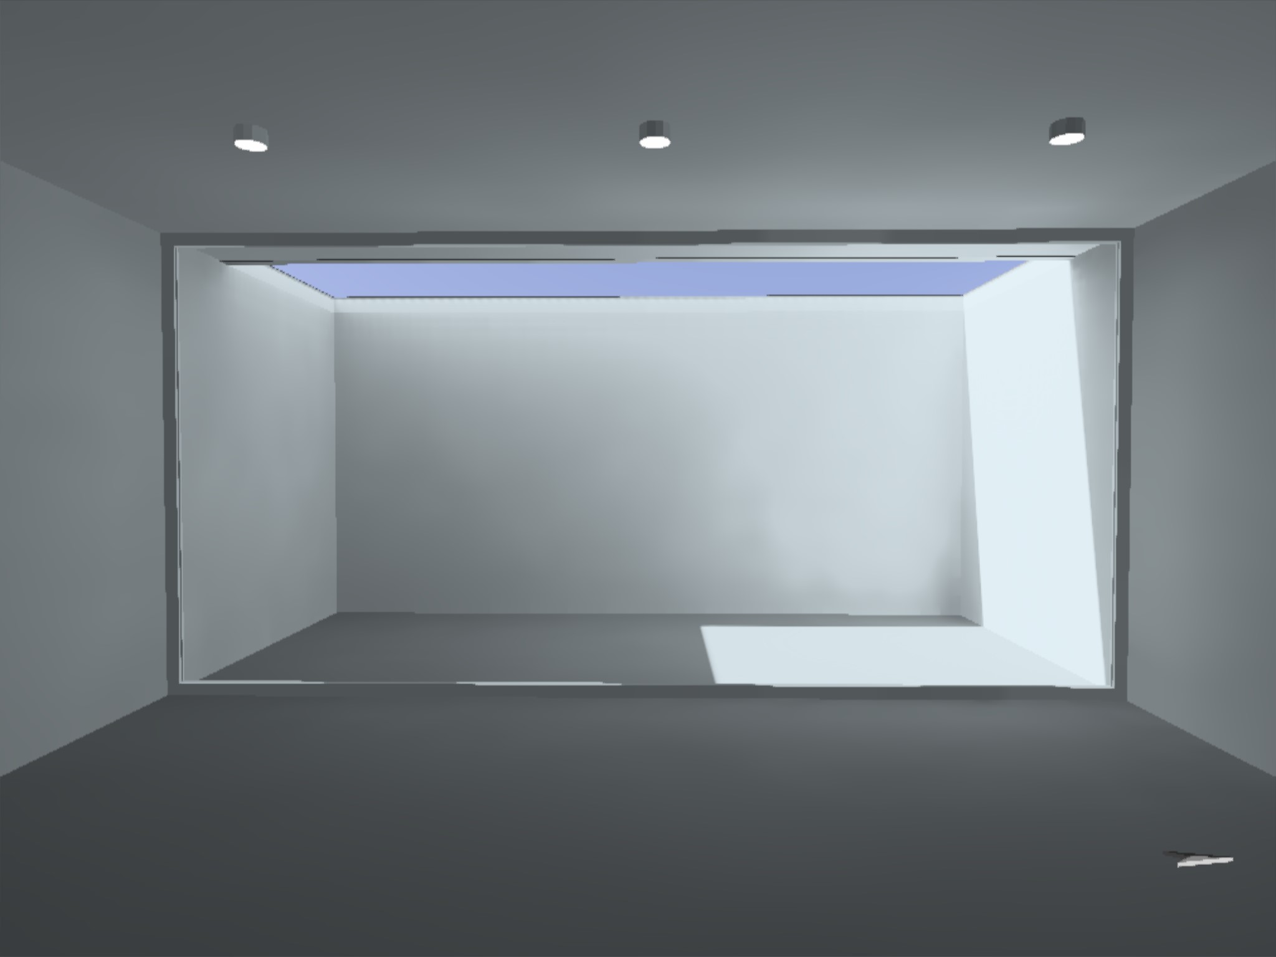
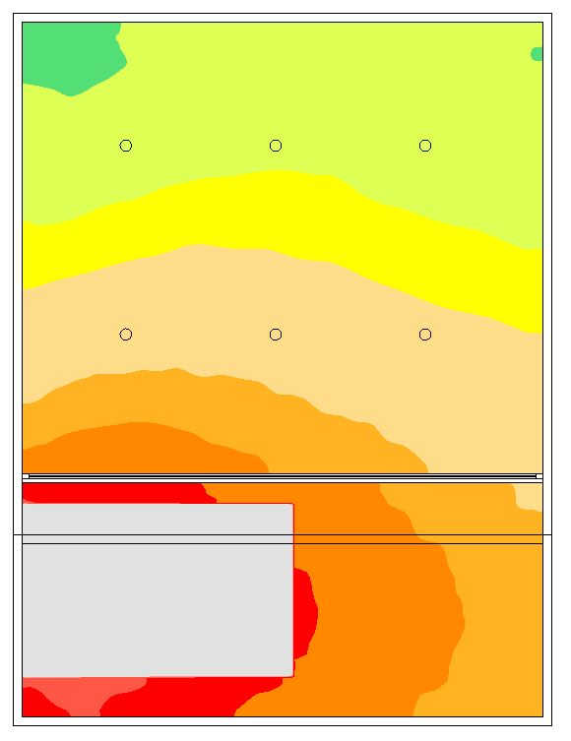
~500 lx
500-700 lx
700-1000 lx
1000-2500 lx
2500-4000 lx
4000-5000 lx
Daylight Analysis | DiaLux
Cut-out: 3.0m Wide
04AM, 21st June ‘19
GNLU, Gandhinagar

